Slide 1
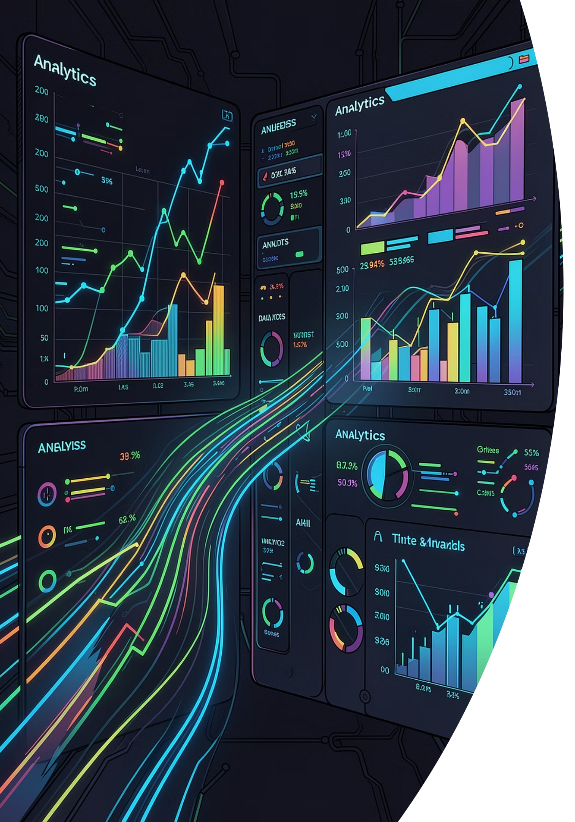
End-to-End E-Commerce Data Platform
Sales and Customer Analytics — A Data Engineering Capstone Project
MASTER'S IN DATA SCIENCE
DATA ENGINEERING PROJECT
Vishwa Narayanaswamy · Sheerin Banu Shiek Mohamed · Koushik Raj Singh

Slide 2

Introduction
E-commerce platforms generate massive volumes of data daily — from purchases and searches to clicks and transactions. Managing this data manually is slow, error-prone, and unsustainable at scale.
Collect
Ingest raw data from multiple e-commerce sources automatically
Clean & Transform
Preprocess and standardize data for consistent analysis
Store
Load processed data into a centralized data warehouse
Analyze
Generate real-time insights and interactive dashboards

Slide 3

Aim & Objectives
Project Aim
Key Objectives
To build a scalable and automated e-commerce data platform that enables end-to-end sales and customer analytics — from raw data ingestion to actionable business intelligence.
Automate data collection and preprocessing pipelines
Execute ETL operations efficiently and reliably
Store transformed data in a centralized warehouse
Analyze customer behavior and sales patterns
Build interactive dashboards for business stakeholders

Slide 4
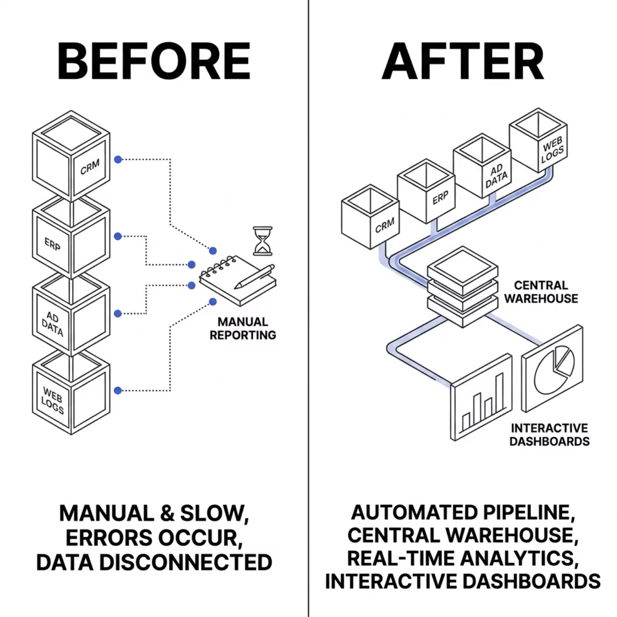

Problem Statement
The Challenge
E-commerce businesses generate data across orders, customers, products, and transactions — but this data is fragmented across siloed systems, making unified analysis nearly impossible.
Scattered Data
Manual Reporting
No Real-Time Analytics
Multiple disconnected sources with no unified schema
Slow, error-prone processes that delay decisions
Businesses react to trends too late

Slide 5
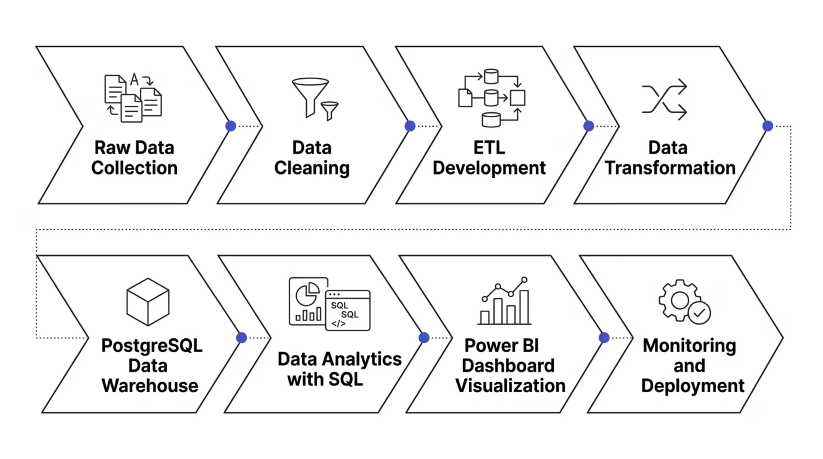

End-to-End Workflow
The platform follows a structured eight-stage pipeline — from raw data ingestion through to monitored, production-ready analytics.
Each stage is automated and containerized, ensuring reproducibility, scalability, and minimal manual intervention throughout the data lifecycle.

Slide 6
Tools & Technologies
Python, Pandas & NumPy
Apache NiFi & Airflow
Apache Spark
Data cleaning, transformation, and statistical analysis
Automated data ingestion and workflow orchestration
Distributed, large-scale data processing
PostgreSQL & SQL
Docker
Power BI / Tableau
Relational data warehouse and query analytics
Containerization for consistent deployment environments
Interactive visualization and business intelligence
Git & GitHub
Version control and collaborative development

Slide 7

Data Sources
What We Process
The platform integrates structured and semi-structured data from six core e-commerce domains, representing high-volume, multi-source business records.
👤 Customer Data
📦 Product Data
💳 Sales Transactions
🛒 Order Details
💵 Payment Info
🚚 Shipping Data

Slide 8

Data Preparation
Raw e-commerce data is inherently noisy. A rigorous preparation layer ensures only high-quality, consistent records enter the warehouse.
Transform & Standardize
Remove Duplicates
Deduplicate and validate unique entries.
Format fields and normalize values.
Handle Missing Values
Feature Engineering
Impute or remove incomplete records.
Create derived metrics and aggregates.
Python, Pandas, and NumPy power every preparation step — improving accuracy, consistency, and downstream analytics performance.

Slide 9



Team Contributions
Vishwa Narayanaswamy
Sheerin Banu Shiek Mohamed
Koushik Raj Singh
Raw data collection and ingestion
Data cleaning and preprocessing
Data quality management
ETL workflow development
Apache Airflow pipeline orchestration
Docker setup and deployment monitoring
Data warehouse design and SQL analytics
Power BI dashboard creation
Documentation and testing

Slide 10
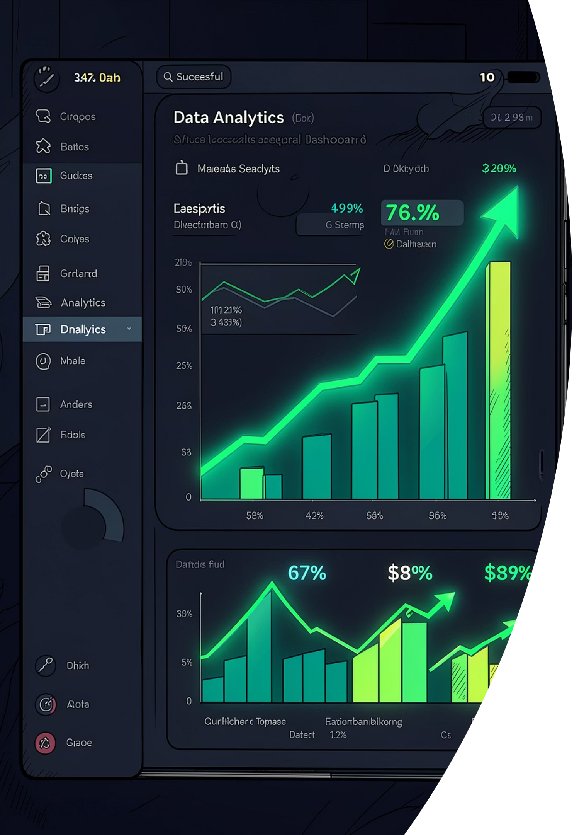

Conclusion
This project demonstrates how a well-architected data engineering platform transforms raw, fragmented e-commerce data into actionable business intelligence.
Automated ETL
Reliable, scheduled pipelines with minimal manual effort
Centralized Storage
Single source of truth in PostgreSQL warehouse
Real-Time Analytics
Up-to-date insights for faster decision-making
Interactive Dashboards
Power BI visualizations accessible to stakeholders
This project underscores the critical role of scalable data engineering in enabling modern e-commerce businesses to compete on insight, not just inventory.

